Slide 1
Kubernetes 101
Author name
Date

Slide 2



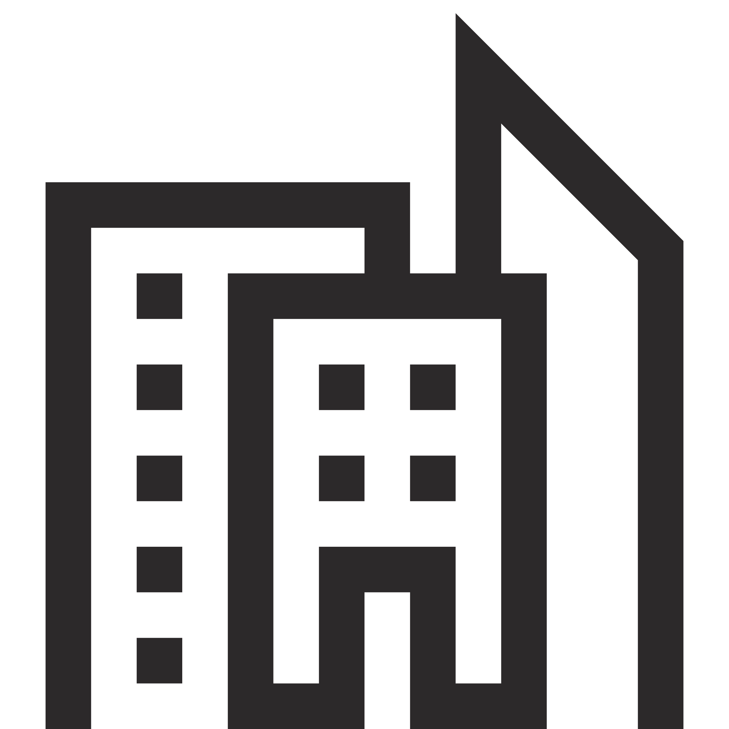
Kubernetes: deploy and manage containerized workloads/services at scale
Kubernetes is…
Portable Public, private, hybrid, multi-cloud
Extensible Modular, pluggable, hookable, composable
Self-healing Auto-placement, auto-restart, auto-replication, auto-scaling
Flexible Facilitates both declarative configuration and automation
Enterprise-ready Supported by a large, and growing ecosystem

Slide 3
Kubernetes is complex
Agent pools
User
2
Control Plane: manages the agent nodes and the pods in the cluster
api-server: front end of the Kubernetes control plane; exposes Kubernetes API
controller-manager: runs the controller processes
scheduler: tracks newly created pods and selects node to run them on
etcd: stores the state of the cluster (config, running workloads status, etc.)
Agent nodes: run your application workloads
Pods: a collection of containers co-located on a single machine
kube-proxy: a network proxy that runs on each node in a cluster
kubelet: agent that runs on each node in a cluster; ensures containers are running in a pod
Containers: software responsible for running containers
Agent node
kubelet
kube-proxy
Internet
1
Control plane
Container runtime
api-server
Pods
Pods
Containers
Containers
controller-manager
scheduler
Agent node
kubelet
kube-proxy
Internet
replication, namespace, serviceaccounts, etc.
etcd
Container runtime
Pods
Pods
Containers
Containers

Slide 4
How does Kubernetes work?
User
Scenario: Maintain configuration while handling failure
Image
IP address
Kubernetes
Problem is detected in one of the pods and a new pod is created as replacement
YAML
Kubernetes Service
Liveness check and readiness check are performed on the new pod
Cloud load balancer
Control plane
Customer VMs
Load balancer starts directing incoming traffic to the newly created pod
Developer
Pods
Pods
Pods
api-server
Containers
Containers
Containers
Grace period provided for existing users
Internet
Pods
Liveness check

Containers
Problematic pod is terminated. Configuration is fully restored.
Readiness check


Slide 5
For Infrastructure and Operations managers

Slide 6
Increase operational efficiency
Focus on your containers and code, not the plumbing of them
Responsibilities | DIY with Kubernetes | Managed Kubernetes on Azure
Containerization
Application iteration, debugging
CI/CD
Provisioning, upgrades, patches
Reliability availability
Scaling
Monitoring and logging
Azure managed control plane
App/ workload definition
Self-managed master node(s)
Kubernetes API endpoint
etcd Store
User
API server
Scheduler
Controller Manager
Cloud Controller
Schedule pods over private tunnel
Customer VMs
Docker
Docker
Docker
Docker
Docker
Pods
Pods
Pods
Pods
Pods
Customer
Microsoft
Notes:
A Kubernetes cluster is typically made up of
Control plane for system components like the API server, etcd store, and scheduler
Agent nodes for user container workloads
Managing the cluster involves:
Monitoring the API server
Ensuring HA/DR for the etcd store
Safely managing upgrades across Kubernetes versions
Safely scaling the cluster in and out
Patching master and agent VM nodes
And on and on…
This is complex, error-prone, and expensive
A managed service like AKS moves those tasks to the cloud provider

Slide 7



Increased operational efficiency
Highly available, reliable service with serverless scaling
Teleport
User
Easily provision fully managed clusters with automatically configured monitoring capabilities based on Prometheus
Real-time personalized recommendations to optimize your AKS deployments with Azure Advisor integration
Elastically add compute capacity with serverless Kubernetes in seconds without worrying about managing the infrastructure.
Higher availability using redundancies across availability zones, protecting applications from datacenter failures
Trusted Advisor
AKS prod cluster
Auto repair
Microservices
Availability
Auto upgrade
Auto scaling
Monitor
Virtual node
Pods
∞
Notes:
Seller note: Requires ONE (1) click of animation.

Slide 8
Azure makes Kubernetes easier
Manage and operate Kubernetes with ease
Task | The Old Way | With Azure
Create a cluster | Provision network and VMs Install dozens of system components including etcd Create and install certificates Register agent nodes with control plane | az aks create
Upgrade a cluster | Upgrade your master nodes Cordon/drain and upgrade Agent nodes individually | az aks upgrade
Scale a cluster | Provision new VMs Install system components Register nodes with API server | az aks scale

Slide 9
Serverless Kubernetes using AKS virtual nodes
Elastically provision compute capacity in seconds
No infrastructure to manage
Built on open sourced Virtual Kubelet technology, donated to the Cloud Native Computing Foundation (CNCF)
Node
Node
Pods
Pods
Azure Container Instances (ACI)
Kubernetes control plane
Pods
Virtual node
Notes:
More information: https://azure.microsoft.com/en-us/blog/bringing-serverless-to-azure-kubernetes-service/
Virtual nodes feature is currently only available for Linux.

Slide 10
Horizontal Pod Autoscaler
The horizontal pod autoscaler (HPA) uses the Metrics Server in a Kubernetes cluster to monitor the resource demand of pods. If a service needs more resources, the number of pods is automatically increased to meet the demand.
͏HPA obtains resource metrics and compares them to user-specified threshold
2
Node1
Horizontal Pod Autoscaler
Pod
3
Deployment
ReplicaSet
͏HPA evaluates whether user specified threshold is met or not
replicas++
Kubelet
replicas--
4
cAdvisor
Pod
͏HPA increases/decreases the replicas based on the specified threshold
Grabs metrics
1
NodeX
͏The Deployment controller adjusts the deployment based on increase/decrease in replicas
Metrics Server
Node2
Pod
Collects metrics from all containers on the node
Kubelet
Collects metrics from all nodes
cAdvisor

Slide 11
Cluster Autoscaler
The cluster autoscaler watches for pods that can't be scheduled on nodes because of resource constraints. The cluster then automatically increases the number of nodes.
͏HPA obtains resource metrics and compares them to user-specified threshold
Cluster Autoscaler
Azure
Pod
Pod
2
1
͏HPA evaluates whether user specified threshold is met or not
Additional nodes needed
Pods are in pending state
͏HPA increases/decreases the replicas based on the specified threshold
3
Pending pods are scheduled
Node is granted
4
͏The Deployment controller adjusts the deployment based on increase/decrease in replicas
AKS cluster
Node
Node
Pod
Pod
Pod
Pod

Slide 12


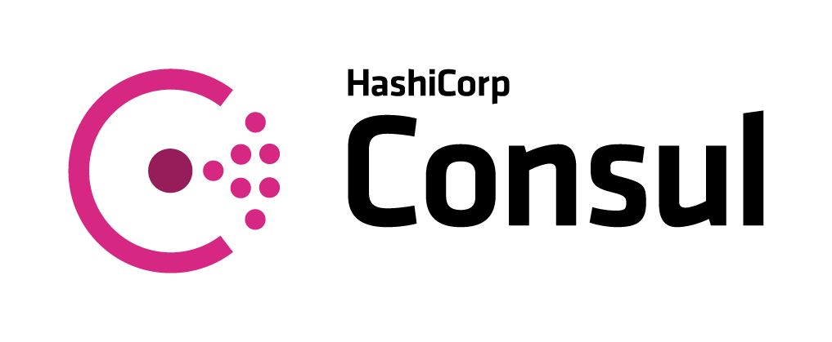

Service Mesh Interface (SMI)
Apps
Tooling
Ecosystem
SMI defines a set of APIs that can be implemented by individual mesh providers. Service meshes and tools can either integrate directly with SMI or an adapter can consume SMI and drive native mesh APIs.
​Standard interface for service mesh on Kubernetes​
​Basic feature set to address most common scenarios​
​Extensible to support new features as they become widely available​
Service Mesh Interface
Routing
Telemetry
Policy
…and more
Kubernetes

Slide 13

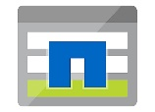
Azure Storage options
Azure Disk Storage
Azure File Storage
Azure Blob and Data Lake Storage
Azure NetApp Files via Trident
 | High, performance, durable block storage for Azure Virtual Machines | Simple, secure, and serverless enterprise-grade cloud file shares | Massively scalable and secure object storage and data lake | Enteprise file storage, powered by NetApp
Workloads | Databases, bigdata, cache, CI/CD | Shared/user workspace, CMS, databases, AI/ML | Analytics on data lake | Analytics, HPC, Custom apps currently using NetApp
Access protocol | SCSI | SMB, NFS v4.1 (preview) | Blobfuse, NFS v3.0 (preview) | NFS v3.0, NFS v4.1
Model | Static, Dynamic | Static, Dynamic | Static, Dynamic | Static, Dynamic
SKUs | Standard HDD, Standard SSD, Premium SSD, Ultra (v1.20) | Standard HDD, Premium SSD | Standard HDD, Premium SSD | Standard, Premium, Ultra
Access modes | ReadWriteOnly (RWO), ReadWriteMany (RWX) (v1.20) | RWO, RWX | RWO, RWX | RWO, RWX
Container type | Linux, Windows | Linux, Windows, ACI | Linux | Linux
Redundancy | Locally-redundant storage (LRS), Zone-redundant storage (ZRS) - coming soon | LRS, ZRS, Geo-redundant storage (GRS), Read-access geo-redundant storage (RAGRS) | LRS, ZRS, GRS, RAGRS | Single-zone
https://docs.microsoft.com/bs-latn-ba/azure/aks/concepts-storage

Slide 14
For developers and DevOps specialists

Slide 15


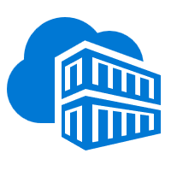
Accelerate containerized development an iterative Kubernetes development experience for teams with integrated CI/CD
Inner loop
Visual Studio Code
AKS dev cluster
sample code {
iterating.with.team
// in one
// isolated
environment
}
Test
Native containers and Kubernetes support in Visual Studio Code
Private container registry with Helm support
Develop and test Kubernetes apps without mocking up dependencies
Effective code merge, containerization, and CI/CD pipeline with automated tasks in a few clicks
Pre-configured canary deployment strategy
In-depth build and delivery process review and integration testing
</>
Debug
Azure Container Registry
Source code control

AKS production cluster
Release
3
Container image
Azure Pipelines
CI/CD Pipelines
Helm chart
Release 3
Release N
Release 3
Release 2
Release
1

Slide 16
Azure makes Kubernetes easier
Accelerate containerized application development
Task | The Old Way | With Azure
Inner loop development | Set up a local dev environment using Minikube Determine the transitive closure of your dependencies Identify behavior of dependencies for key test cases Stub out dependent services with expected behavior Make local changes, check-in, and hope things work Validate with application logs | Use Visual Studio Code to run and debug services locally while connected to existing services and dependencies without having to mock them
Set up a CI/CD pipeline and deploy to Kubernetes | Create Git repo Create a build pipeline Create a container registry Create a Kubernetes cluster Configure build pipeline to push to container registry Configure build pipeline to deploy to Kubernetes Define and set up deployment strategy | Store source code on GitHub, then create a project on Azure Pipelines with Kubernetes/AKS as a target
Make container images available for deployment worldwide | Create a container registry in every region Configure build pipeline with multiple endpoints Loop through all regions and push following build | Create an Azure Container Registry with geo-replication Push your image to a single endpoint
Track health with consolidated cluster and application logs | Choose a logging solution Deploy log stack in your cluster or provision a service Configure and deploy a logging agent onto all nodes | Checkbox enable monitoring with centralized tracking of logging and analytics

Slide 17


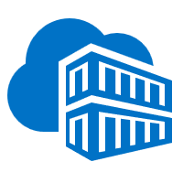
Unmatched agility
Powered by automation and integration with familiar tools
Automatically containerize and scaffold any applications directly from IDE
Container
2
Container Registry
Auto-build to a secure container registry
App
1
3
Rapidly iterate, test, and debug microservices
A few clicks to a full CI/CD pipeline and pre-configured deployment strategy
Production environment
5
Built-in monitoring and logging to get full visibility of container health and app telemetry
Monitoring and logging
4

Slide 18


Azure Pipelines for AKS
Deep traceability
3
͏As part of the CI, developers check in their code to a central repository, like GitHub; Azure Pipelines automatically builds application binaries, runs unit test, and pushes container image into a registry
Source Repository
Container image
Pod
͏Developers then deploy the application to a testing environment and run integration test as part of the CD workflow
͏Developers can review which pod is running which container image, what source code is built into an image, and what tests are run against each image at any point of time
Source code
Release Pipelines
AKS cluster
1
Build Pipelines
2
4
Continuous Integration
Continuous Delivery
Deploy strategies
͏For production deployment, Azure Pipelines automatically executes pre-defined deployment strategy and progressively rolls out application to an AKS cluster
Azure Monitor
͏Enable app telemetry, container health monitoring, and real-time log analytics; insights used to address issues and feed into next sprint plans
Iterate
5
Monitor

Slide 19
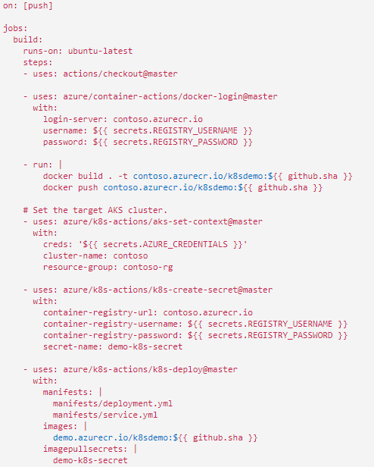
GitHub Actions for Kubernetes on Azure
͏Authenticate and login securely to an Azure subscription
Action docker-login
1
͏Set the target AKS cluster
Action aks-set-context
2
͏Create Kubernetes secret objects to manage sensitive information
͏Connect to the Kubernetes cluster and deploy manifests, etc.
Action k8s-create-secret
3
Action k8s-deploy
4

Slide 20
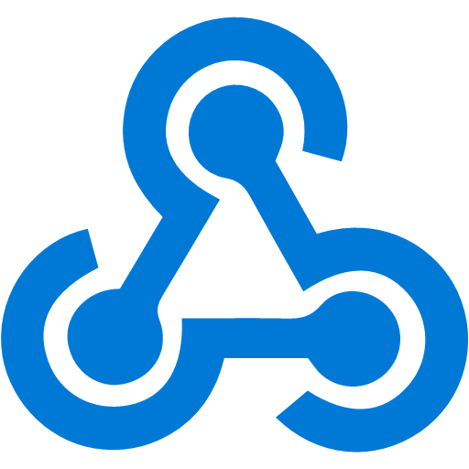
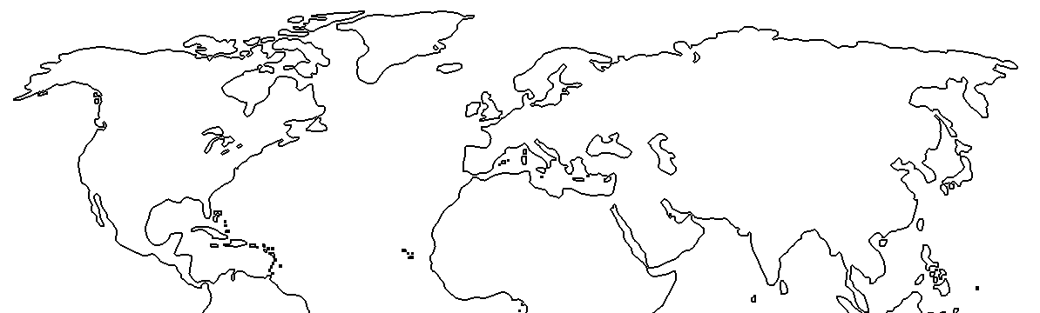
Azure Container Registry geo-replication
Push image to a single registry and ACR takes care of geographical replication, including local notifications.
Container image
Developer
͏US-based developer commits codes to build container image
1
</>
Image is pushed to the nearest Azure Container Registry (ACR) region based on DNS
3
5
East US
contoso.azurecr.io
contoso.azurecr.io
West Europe
2
͏Geographical webhook triggers deployment to East US
AKS
CD
ACR
ACR
CD
AKS
͏ACR geo-replicates to configured regions
Geo-Replication
͏Geographical webhook triggers deployment to West Europe
contoso.azurecr.io/app:v1
4
contoso.azurecr.io/app:v1
6
6
͏Both AKS clusters pull from contoso.azurecr.io
Notes:
Feature benefits
Manage a single registry across all regions: contoso.azurecr.io
Manage a single configuration of image deployments as all regions used the same image URL: contoso.azurecr.io/app:v1
Push to a single registry, while ACR manages the geo-replication, including regional webhooks for local notifications
No need to configure registry access for each region
Eliminates the need for development teams to push images to different registries and configure/maintain each regional deployment with image names referencing the local registry
Reduced egress fees for remote clusters

Slide 21
Kubernetes-based event-driven auto-scaling (KEDA)
Open-source component jointly built by Microsoft and RedHat
Event-driven container creation & scaling Allows containers to “scale to zero” until an event comes in, which will then create the container and process the event, resulting in more efficient utilization and reduced costs
​Native triggers support Containers can consume events directly from the event source, instead of routing events through HTTP
​Can be used in any Kubernetes service This includes in the cloud (e.g., AKS, EKS, GKE, etc.) or on-premises with OpenShift—any Kubernetes workload that requires scaling by events instead of traditional CPU or memory scaling can leverage this component.
Kubernetes cluster
Scaler
AKS cluster
External trigger source
Controller
Metrics adapter
KEDA

Slide 22

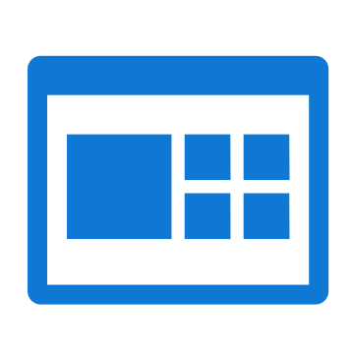

Azure Monitor for containers
Azure Monitor for containers
Prometheus
Get detailed insights about your workloads with Azure Monitor
Cloud native experience for Azure Monitor with Prometheus integration
Observe live container logs and Kubernetes event log on container deployment status
Filter for details about nodes, controllers, and containers
Visualization
2
Visualize overall health and performance from cluster to containers with drilldowns and filters
Azure Kubernetes Service
See graphical insights about clusters
Azure Pipelines
Observability
Pull events and logs for detailed activity analysis
1
Insights
3
Provide insights with cluster health rollup view
Monitor & analyze
4
Monitor and analyze Kubernetes and container deployment performance, events, health, and logs
Virtual node
Response
Native alerting with integration to issue management and ITSM tools

Slide 23
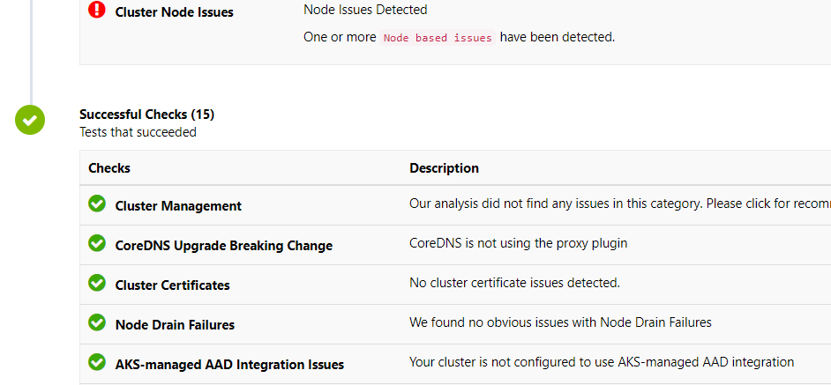

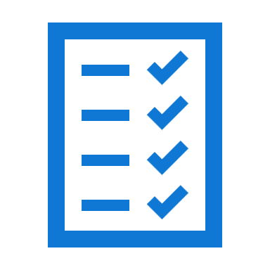
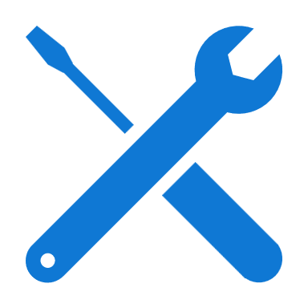
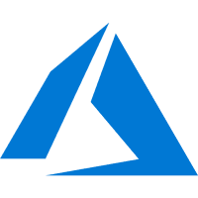
AKS diagnostics
Faster resolution of common issues with an intelligent, self-diagnostic experience right in the portal
Cluster-specific observations
Recommended actions for troubleshooting
AKS diagnostics Sample diagnostics web portal
<\>
Zero configuration and zero cost
Intelligent detectors based on AKS-specific telemetry
Cluster-specific observations
Recommended actions for troubleshooting
Azure portal
Azure backend telemetry
AKS production cluster
User
Node 1
Node 2

Slide 24
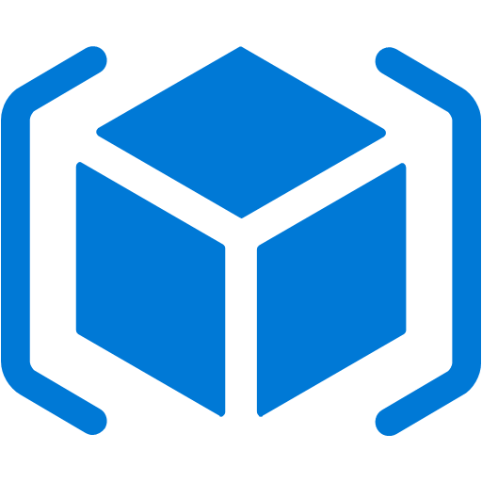
Azure Monitor for containers
Configuration management scenario
Azure Resource Manager
Cluster operator
Cluster Connect RP
Deploy Azure Arc for Kubernetes agent
1
Kubernetes on-prem
Azure Arc agent registers cluster with ARM
Azure Arc agent
2
3
Cluster Config RP
Cluster operator applies cluster configuration via ARM
4
Config agent
Configuration agent picks up configuration and syncs state from git repo
Azure Policy
5
Configuration agent informs Azure policy of status
6
Cluster operator/ Application dev
GitHub
Cluster operator or application developer pushes changes via GitHub

Slide 25
API-driven development with Kubernetes:
overview
Putting API at the center of the development process to clearly separate app accessibility and app logic
API defines how internal world communicates with outside world
External interface to the world
Formalizes parameters for internal and external user access
Allows definition and enforcement of policies, like security and usage
Provides abstraction of the underlying details
Enables decoupling of interface development from logic development
Acts as proxy for app logic
Cloud app
Website
Kubernetes platform
API
Security, governance, identity
Kubernetes
Infrastructure automation
Kubernetes provides app orchestration environment and scalability needs
Mobile app
B2B partner
Infrastructure
Simplifies migration and modernization
Enables developers to focus on app logic
Provides orchestration and scalability across apps and services
Accessibility
Logic
Notes:
“API management is the process of creating and publishing web APIs, enforcing their usage policies, controlling access, nurturing the subscriber community, collecting and analyzing usage statistics, and reporting on performance
API with Kubernetes ---
Migrate legacy apps to the cloud
Modernize infrastructure & processes (CI/CD, automation, etc.)
Decouple code from usage to add new services or selectively expose functionality to new uses

Slide 26
API-driven development with Kubernetes: architecture
Putting API at the center of the development process to clearly separate app accessibility and app logic
App developers
API is defined by API developers and published via the API Management portal
2
API
Application developers define the microservices and associated logic and deploy to Kubernetes
API developers
Management Portal
Kubernetes platform
1
Security, governance, identity
API users (internal and/or external) use the API developer portal to learn about the API and use them in their applications
API users
Developer Portal
Kubernetes
5
3
Infrastructure automation
Applications access APIs via the API Gateway
Gateway
Infrastructure
4
API Gateway, after ensuring the API request meets security and other policies e.g. throttling, forwards the request to service running in Kubernetes
Accessibility
Logic

Slide 27
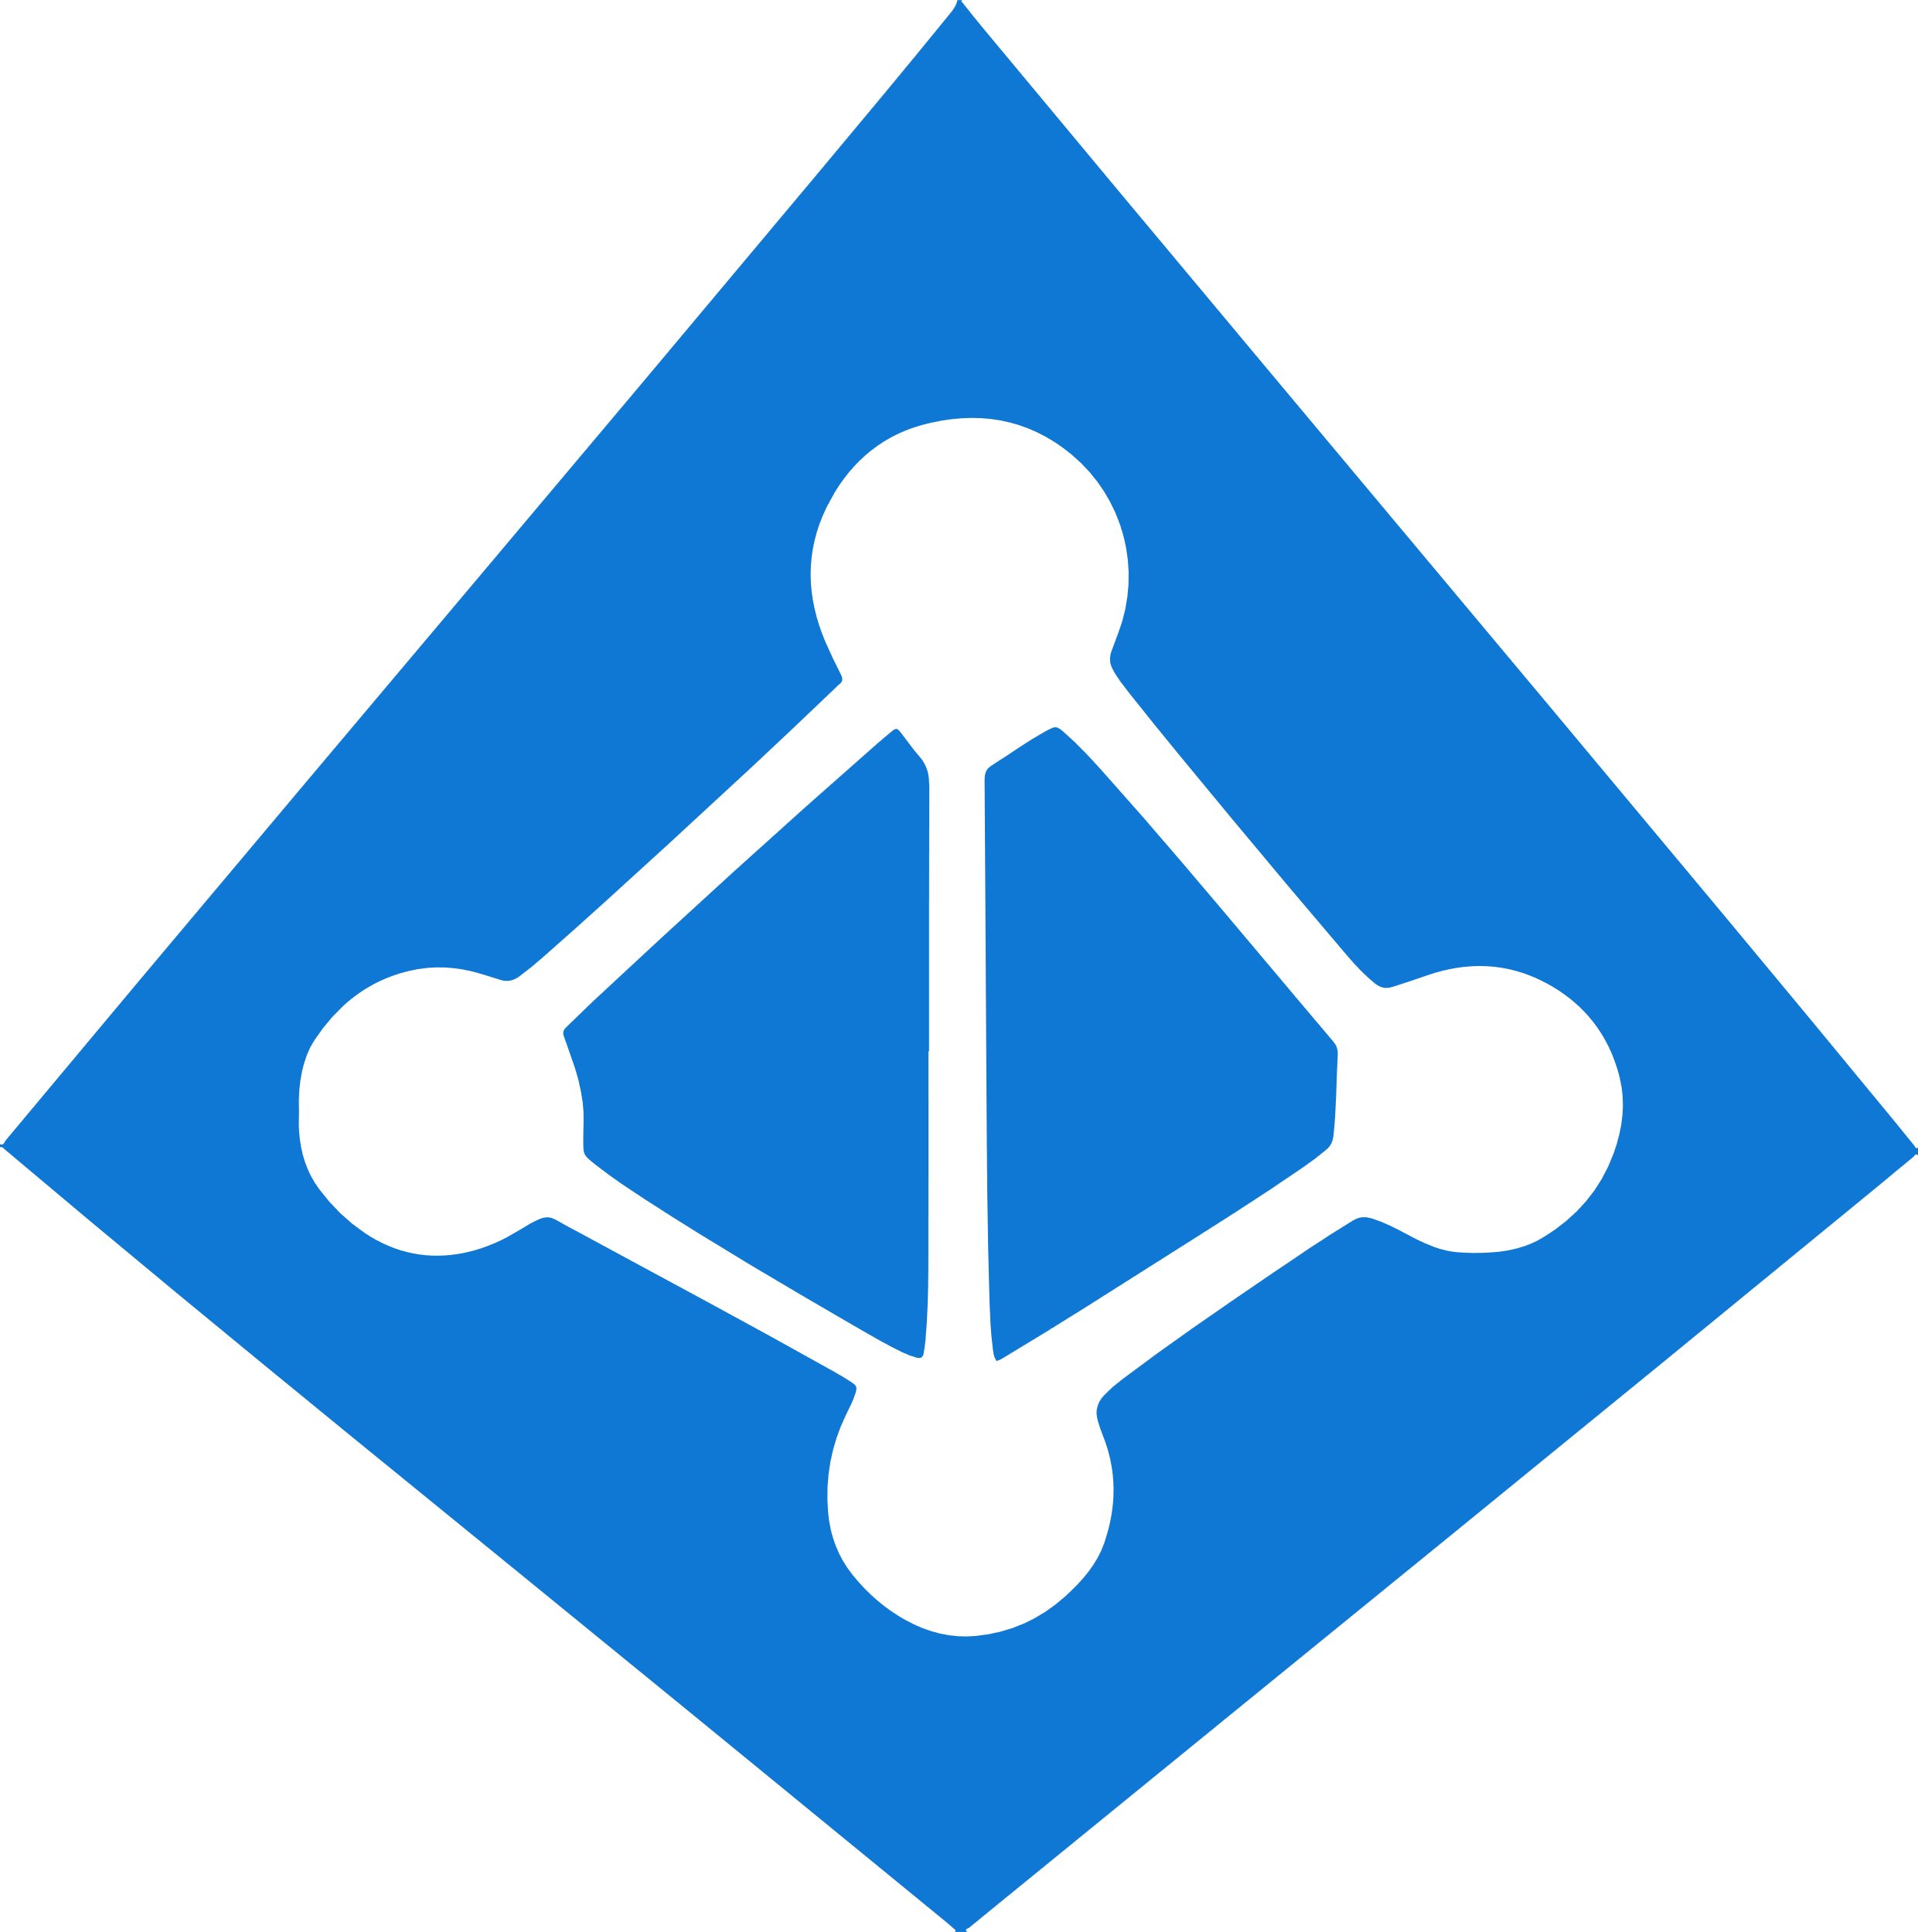


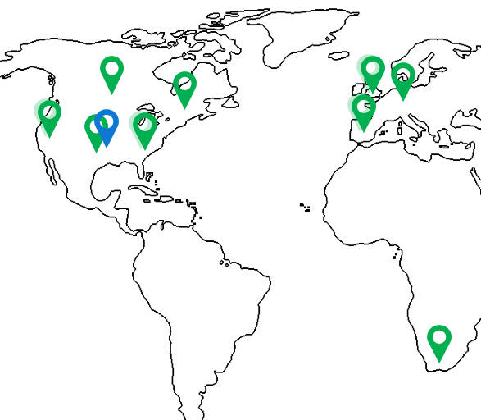


API-driven development with Kubernetes: benefits
Putting API at the center of the development process to clearly separate app accessibility and app logic
Benefits of using API with Azure
Create API gateway and developer portal in minutes
Publish APIs easily for internal or external use
Manage, secure, optimize all your APIs in one place
Connect to back-end services anywhere
Kubernetes
API
Management Portal
Security, governance, identity
Enabling technologies
Developer Portal
Broad support for technologies to fit your migration, modernization, transformation, and API needs
Extensive infrastructure and services to simplify security, compliance, and standardization
Refined management plane to ease the task of development and management
Support for multi-cloud and hybrid*
On-prem, cloud, or hybrid
Gateway
Infrastructure automation
Accessibility
Logic
*Map illustration represents existing and future availability for Azure. Map is not all-inclusive.

Slide 28
Security & Networking

Slide 29

Identity
Use familiar tools like AAD for fine-grained identity and access control to Kubernetes resources from cluster to containers
Storage
AKS with RBAC
Active Directory
VNet
Active Directory
SQL Database
Node
Node
Synced identity
Pod
Pod
AAD Pod Identity
Cosmos DB
Key Vault

Slide 30
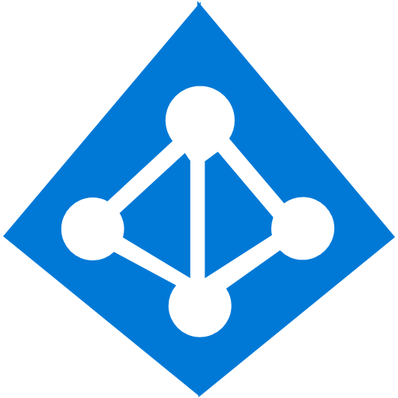
Identity and access management through AAD and RBAC
A developer authenticates to the AAD token issuance endpoint and requests an access token
Azure Active Directory
The AAD token issuance endpoint issues the access token
1
The access token is used to authenticate to the secured resource
Developer
Token
2
AKS
Data from the secured resource is returned to the web application
3
Token
4
Azure delivers a streamlined identity and access management solution with Azure Active Directory (AAD) and Azure Kubernetes Services (AKS)

Slide 31
Pod identity
Developer
Kubernetes operator defines an identity map for K8s service accounts
<\>
Node Managed Identity (NMI) watches for mapping reaction and syncs to Managed Service Identify (MSI)
3
Kubernetes
Kubernetes controller
Azure Identity Binding
Azure SQL Server
Developer creates a pod with a service account, and pod uses standard Azure SDK to fetch a token bound to MSI
1
Pod
Pod uses access token to consume other Azure services; services validate token
Active Directory Pod Identity
Token
Azure MSI
4
NMI + EMSI
2

Slide 32

Image Security
Your private registry, with built-in Helm chart support, only deploys validated images and can be automatically geo-replicated to the data center close to where your users are
Developer
Azure Container Registry
Azure Kubernetes Service
CI/CD Pipelines
Image scanning
Fail
Pass
Admin
Vulnerability scanning
Actionable recommendations

Slide 33
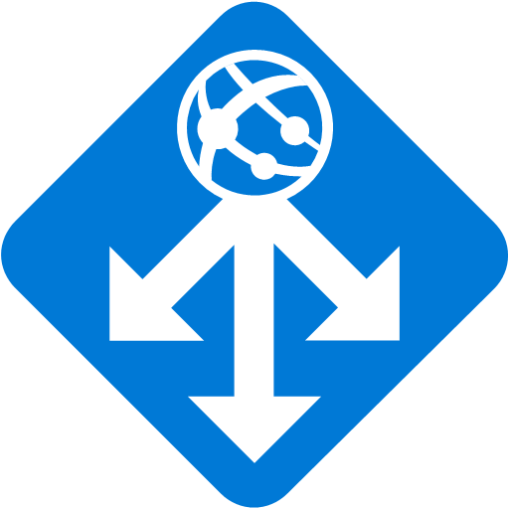
Networking
Secure your Kubernetes workloads with virtual network and policy-driven communication paths between resources
Kubernetes cluster: Azure VNET
Internal Load Balancer
Egress lockdown
External DNS
Control plane
Ingress Controller
App Gateway
Private cluster
Agent node
Agent node
kubelet
Pods
Pods
kubelet
Containers
Containers
Namespace

Slide 34
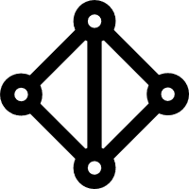
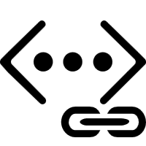
Secure network communications with VNET and CNI
Uses Azure subnet for both your containers and cluster VMs
1
On-premises infrastructure
3
Azure VNet A
Enterprise system
Allows for connectivity to existing Azure services in the same VNet
Backend services subnet
AKS subnet
Azure Express Route
AKS cluster
SQL Server
Use Express Route to connect to on-premises infrastructure
Azure SQL PaaS DB
5
Use VNet peering to connect to other VNets
2
Service Endpoint
Connect AKS cluster securely and privately to other Azure resources using VNet endpoints
VNet peering
Other peered VNets
4
AKS VNet integration works seamlessly with your existing network infrastructure

Slide 35

Governance
Dynamically enforce guardrails defined in Azure Policy across multiple clusters—nodes, pods, and even container images can be tracked and validated at the time of deployment or as part of CI/CD workflows
Cloud Architect
Azure Policy
Compliance reports
Assigns a policy across clusters
Cluster-1
Cluster-2
Cluster-3
Compliance reports for the entire environment, with pod-level granularity
Real-time enforcement of policy and feedback
AKS
Developer
Cluster-1
Cluster-2
Cluster-3

Slide 36
Azure Pipelines build audit & enforcement using Azure Policy
Cloud architect assigns a policy across clusters; policy can be set to block non-compliance (deny) or generate non-compliance warnings (audit)
Cloud Architect
Azure Policy
1
Developer makes code change that kicks off a build on Azure Pipelines
Azure Pipelines evaluates the request for policy compliance
CI/CD Pipelines
4
Yes
Deny policy
No
If policy is set to deny, Azure Pipelines rejects the build attempt if any non-compliance is identified
Developer
Fail
5
Compliance check
AKS
2
3
If policy is set to audit, a non-compliance event is logged and the build is allowed to proceed
Cluster-1
Cluster-2
Cluster-3
Pass

Slide 37
Azure Policy for clusters
Cloud architect assigns a deployment policy across cluster(s)
Cloud Architect
Azure Policy
Developer uses standard Kubernetes API to deploy to the cluster
1
Real-time deployment enforcement (acceptance/denial) provided to developer based on policy
Compliance reports
4
Cluster-1
Cluster-2
Cluster-3
Cloud architect obtains compliance report for the entire environment and can drill down to individual pod level
AKS
Developer
3
Cluster-1
Cluster-2
Cluster-3
2
Notes:
Azure policy for AKS allows users to select from a pre-defined set of policies and assign them to AKS clusters. They can check if resources that are currently deployed to AKS are in compliance with the assigned policies and take the appropriate action to rectify. If users try to create resources that are not compliant they will be denied and presented a message with policy that causing the denial.
Gatekeeper (OSS)
Gatekeeper is a generic policy controller for Kubernetes. It’s backed by open policy agent and allows users to write policy to ensure Kubernetes resources are compliant. Gatekeeper was initial written by MSFT upstream engineers and donated to the open policy agent organization under CNCF. Since then, we have been collaborating with other companies for example Google, Capital One, Commonwealth Bank of Australia, Styra on producing a stable release of the code.

Slide 38

Threat protection Automated threat detection and best practices recommendation for Kubernetes clusters using advanced analytics from Azure Security Center
Azure Security Center
Continuous discovery of managed AKS instances
Actionable recommendations for security best practices
Detect threats across AKS nodes and clusters using advanced analytics
Azure Kubernetes Service
Cluster
Cluster
Cluster

Slide 39

AKS Support in Azure Security Center
1
For managed subscriptions, each new AKS cluster and node are discovered in ASC
Azure Security Center
Continuous discovery of managed AKS instances
Raw security events
ASC monitors AKS cluster for security misconfigurations and provides actionable recommendations for compliance with security best practices
2
Actionable recommendations for security best practices
Audit log
a
Detect threats across AKS nodes and clusters using advanced analytics
ASC continuously analyzes AKS for potential threats based on:
Azure Kubernetes Service
b
Raw security events such as network data and process creation
AKS security configuration
Verified by Security Center
Node1
Node2
Node3
API Server
Kubernetes log audit
Control Plane
Agent nodes
Container runtime
Container runtime
Container runtime
…and reports any threats and malicious activity detected (e.g., “API requests to your cluster from a suspicious IP was detected”)
Security center
Security center
Security center
Notes:
Kubernetes is quickly becoming the new standard for deploying and managing software in the cloud. Few people have extensive experience with Kubernetes and many only focuses on general engineering and administration and overlook the security aspect. Kubernetes environment needs to be configured carefully to be secure, making sure container doors are not left open for attackers. Security Center is expanding its support in the container space to one of the latest growing services in Azure - Azure Kubernetes Service (AKS). The new capabilities in this public preview release include:
Discovery & Visibility - Continuous discovery of managed AKS instances within Security Center’s registered subscriptions.
Recommendations - Actionable items to help customers in complying to security best practices in AKS, such as "Role-Based Access Control should be used to restrict access to a Kubernetes Service Cluster"
Threat Detection - Host and cluster-based analytics
The new capabilities help create awareness and guidance towards security best practices for configuring AKS hosts and orchestration; harden AKS hosts and orchestration, proactively protects from a security breach within a containerized application and blends consistently with the Security Center experience.

Slide 40

Security summary
Internal User
External User
Azure Container Registry
App Gateway
Developer
AKS with RBAC
͏Image and container level security
AAD authenticated Container registry access
ACR image scanning and content trust for image validation
1
Internal Load Balancer
External Load Balancer
͏Node and cluster level security
Automatic security patching nightly
Nodes deployed in private virtual network subnet w/o public addresses
Network policy to secure communication paths between namespaces (and nodes)
Pod Security Policies using Gatekeeper
K8s RBAC and AAD for authentication
Threat protection on nodes
Azure VNet
Active Directory
Ingress Controller
Ingress Controller
External DNS
Kubernetes Admin
Node
Node
Pod
Pod
3
2
AAD Pod Identity
͏Pod level security
Pod level control using AAD Pod Identity
Pod Security Context
Azure Key Vault
4
͏Workload level security
Azure Role-based Access Control (RBAC) & security policy groups
Secure access to resources & services (e.g. Azure Key Vault) via Pod Identity
Storage Encryption
App Gateway with WAF to protect against threats and intrusions
Azure Storage
SQL Database
Cosmos DB
Encrypted Storage

Slide 41
Run anything, anywhere

Slide 42

Run anything, anywhere
Container
Region
Windows
Linux
35+ regions worldwide
Your choice of…
Environment
Public clouds
IoT Edge
Azure Government
Azure Stack
Private data centers
Notes:
From Windows to Linux containers, from public cloud to IoT edge, use Kubernetes on Azure to orchestrate any type of workloads running in the environment of your choice, including Azure Stack and Azure Government.
Azure works with your app modernization goals, helps dial up your Kubernetes skills, and apply best practices in production​.

Slide 43
Azure Kubernetes Service (AKS) support for Windows Server Containers
Now you can get the best of managed Kubernetes for all your workloads whether they’re in Windows, Linux, or both
Lift and shift Windows applications to run on AKS
Seamlessly manage Windows and Linux applications through a single unified API
Mix Windows and Linux applications in the same Kubernetes cluster—with consistent monitoring experience and deployment pipelines

Slide 44



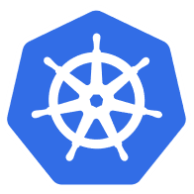

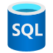



Azure Hybrid Innovation anywhere with Azure
Microsoft Azure
Microsoft Azure
Azure Stack
Azure Arc
Azure IoT
Integrated systems
Any datacenter, any cloud
Any edge device
Management | Security + Identity | App + Data Services | Dev Tools + DevOps

Slide 45
Azure Arc Bring Azure services and management to any infrastructure
Run Azure data services anywhere
Extend Azure management across your environments
Adopt cloud practices on-premises
Implement Azure security anywhere
Azure Arc is a set of technologies that extends Azure management and enables Azure services to run across on-premises, multi-cloud, and edge

Slide 46


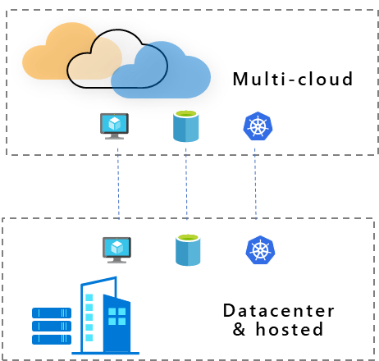
Azure Arc | Customer use cases
Multi-cloud
Datacenter & hosted
Organize and govern across environments
At-scale Kubernetes app management
Run data services anywhere
Get Kubernetes clusters and servers that are sprawling across clouds, datacenters and edge under control by centrally organizing and governing from a single place
Deploy and manage Kubernetes applications at scale across environments using DevOps techniques. Ensure that applications are deployed and configured consistently from source control, at scale
Deploy and manage data services where you need it for latency or compliance reasons. Always use the most current technology and seamlessly manage and secure your data assets across on-premises, clouds and edge

Slide 47



Azure Arc-enabled Kubernetes clusters
͏Central inventory and monitoring of the sprawling assets running anywhere from on-premises to edge
Consistently apply policies, role-based-access-controls (RBAC) for at-scale governance
Deploy Kubernetes resources to all clusters using a GitOps-based workflow
Identity
Monitoring
RBAC
Policy
Azure Arc
Kubernetes
Azure Stack
On-premises
Multi-cloud
Edge

Slide 48






Azure application services
Run your apps, anywhere
App Service
Functions
Logic Apps
API Management
Event Grid
Azure | On-premises | AWS | GCP
Accelerate development with turnkey services
Gain the productivity of PaaS with the control of Kubernetes
Run your apps anywhere with Azure Arc
Notes:
Today we are excited to announce the preview capabilities of Azure application services to run on Kubernetes and anywhere with Azure Arc. You can now run your favorite Azure application services anywhere, including on Kubernetes on Azure, on-premises, on the edge, and on other clouds such as AWS or Google. Any Kubernetes cluster connected through Azure Arc is now a supported deployment target for Azure’s application services.
With these updates,
You can innovate faster by using a suite of application services, tailored to real-world app patterns, loaded with unique features, and optimized for developer productivity
Developers don’t have to choose between the productivity of Azure application services and the control of Kubernetes. You can now run Azure application services on top of Kubernetes.
Lastly, developers don’t have to build and maintain custom solutions for their non-Azure environments. They can now build hybrid and multicloud applications using the portable application services powered by Azure Arc.

